Slide 1
Gesture Based Light Control System
ECE 445 Senior Design Presentation, Group #33
Ian Fitzgerald, Mateusz Chorazy, Debjit Das
May 1, 2018

Slide 2
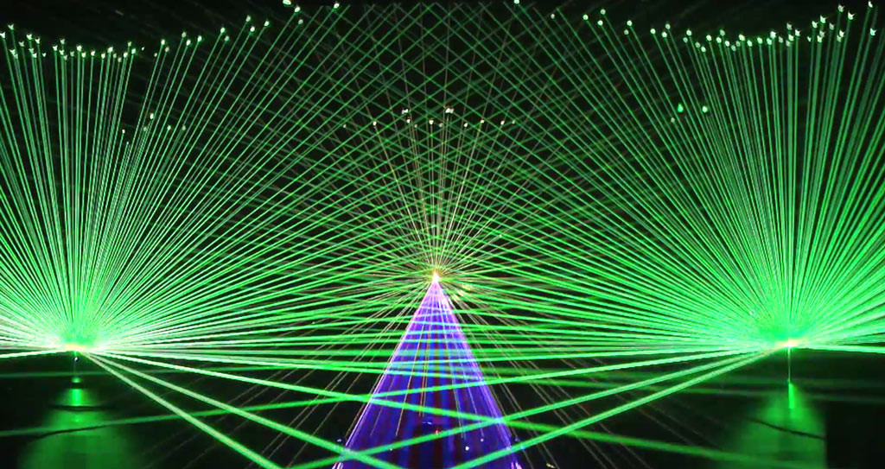
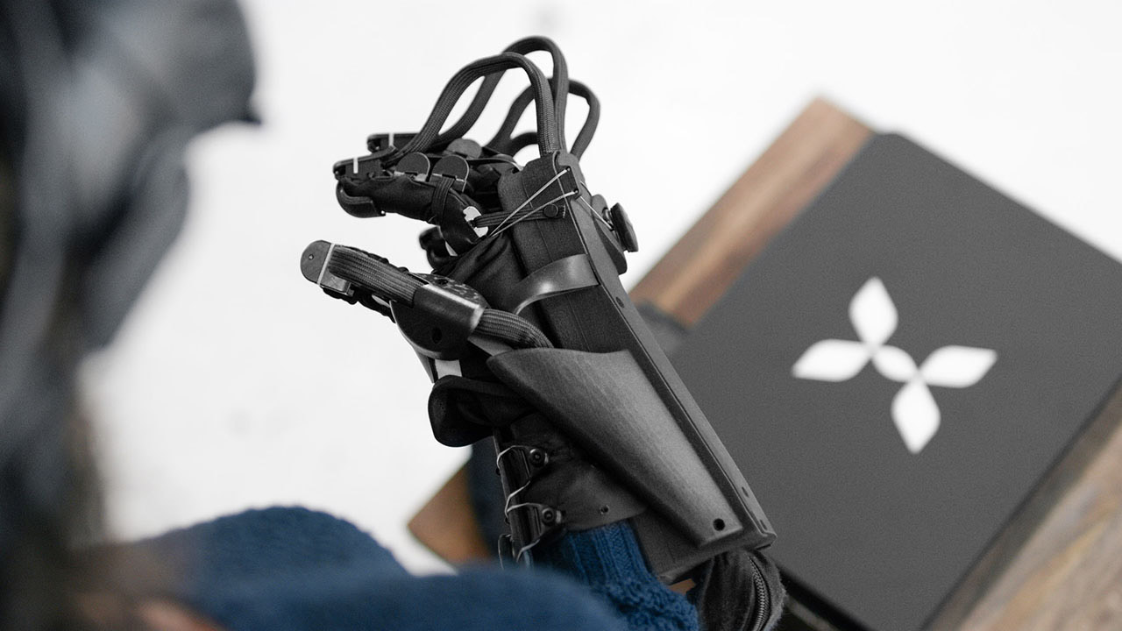
The Inspiration
Direction of modern music concerts
One area untouched
Performer becomes the lighting designer
Source:
RoadtoVR - HaptX
Source:
Laserworld
(Eric Prydz)
Notes:
Debjit
Concerts have incredible lighting design but the designer is almost always specified outside the artist.
The current control units are board. We want to make something more intuitive.

Slide 3
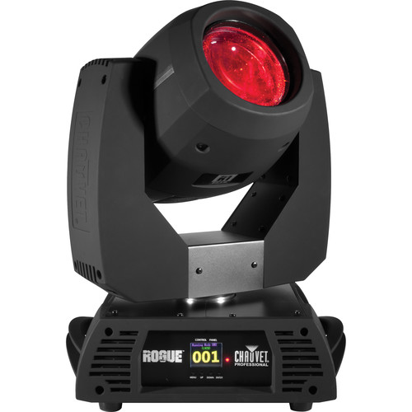
High Level Requirements:
Wirelessly control moving head lights with gestures, up to 30 feet from lights.
Select none, one, or up to two lights.
Distinguish between arbitrary movements and control movements.
Source: B&H Photo
Notes:
Ian

Slide 4
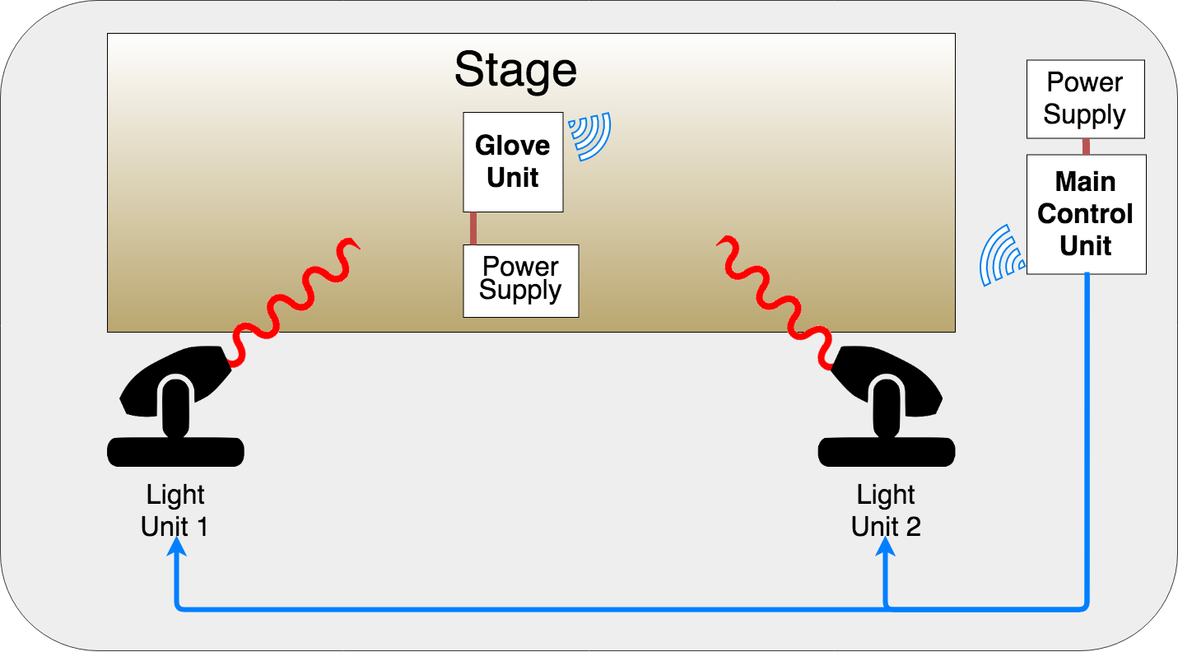
Notes:
Ian

Slide 5
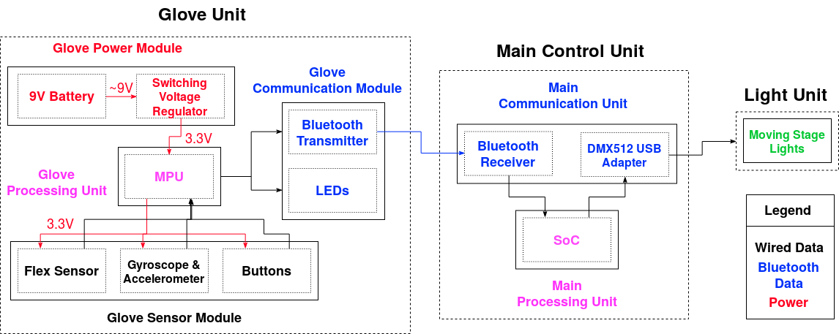
System Overview
Notes:
Mat

Slide 6
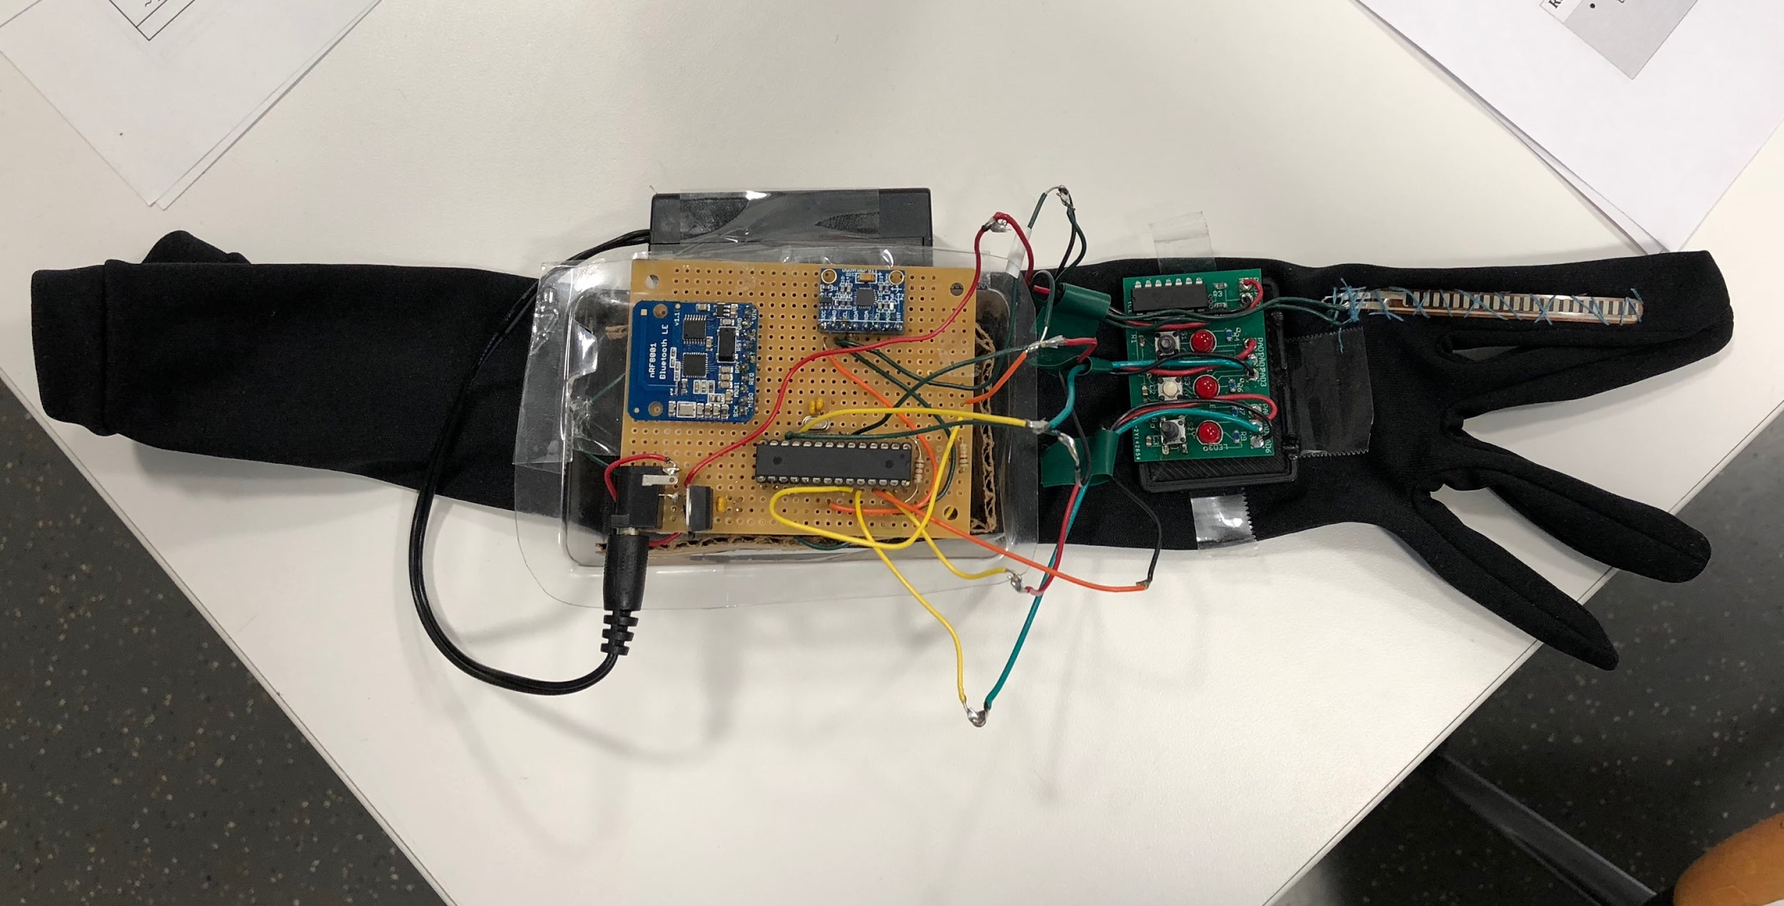
Battery
Gyroscope & Accelerometer Module
Flex Sensor
Bluetooth Module
Microprocessor
Buttons and LEDs
Notes:
Debjit

Slide 7
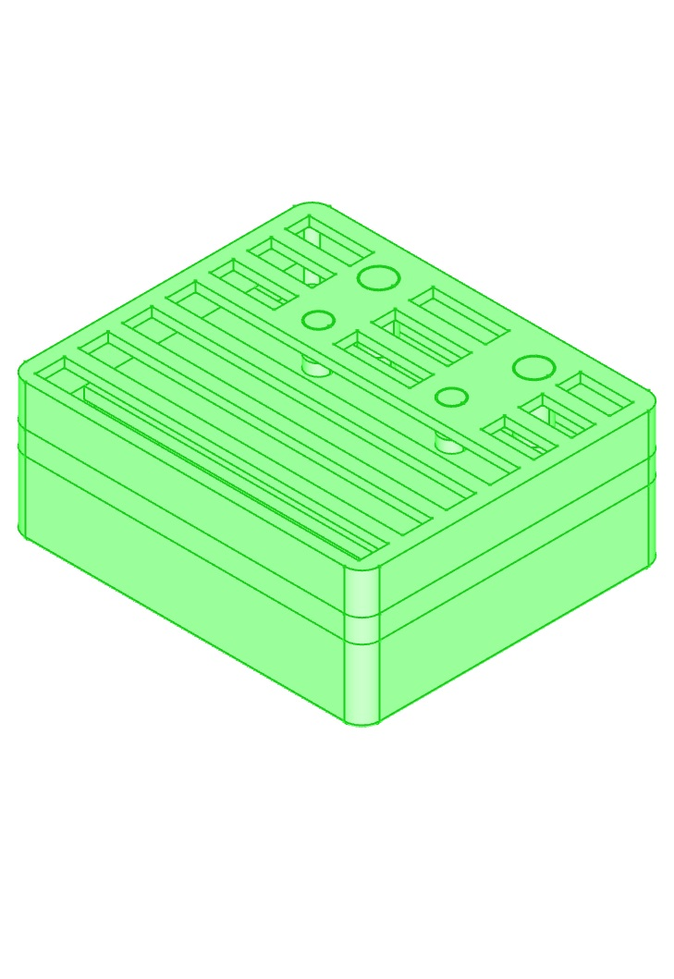
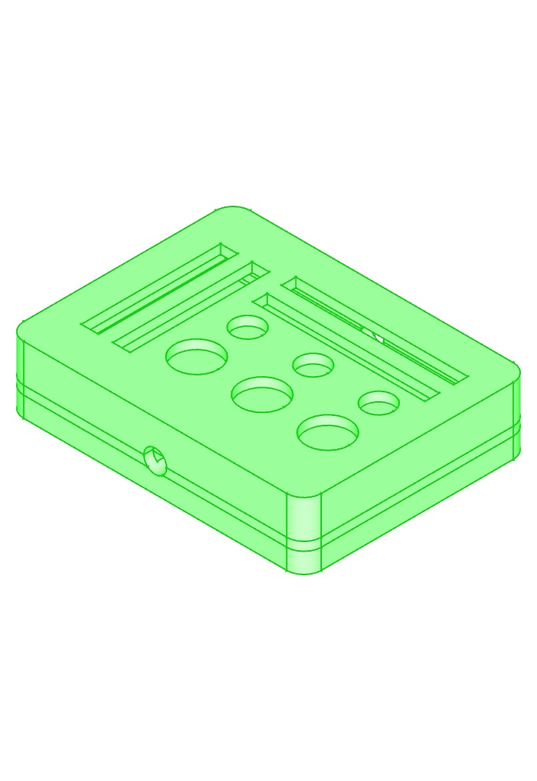
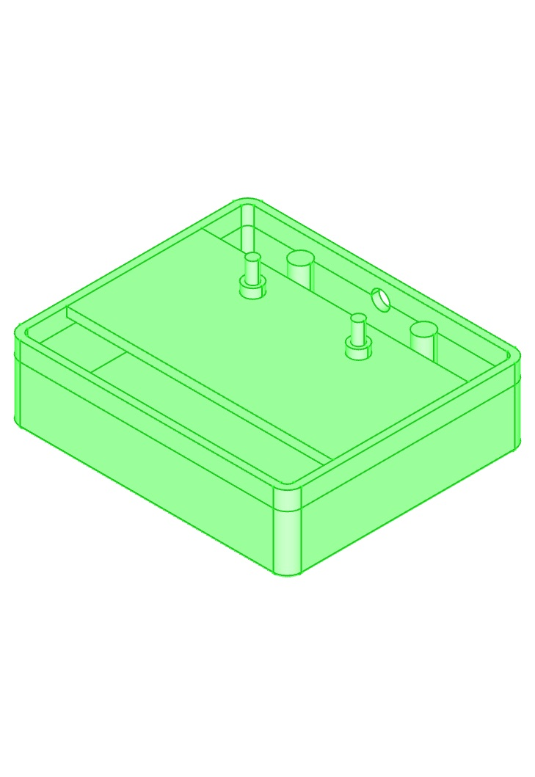
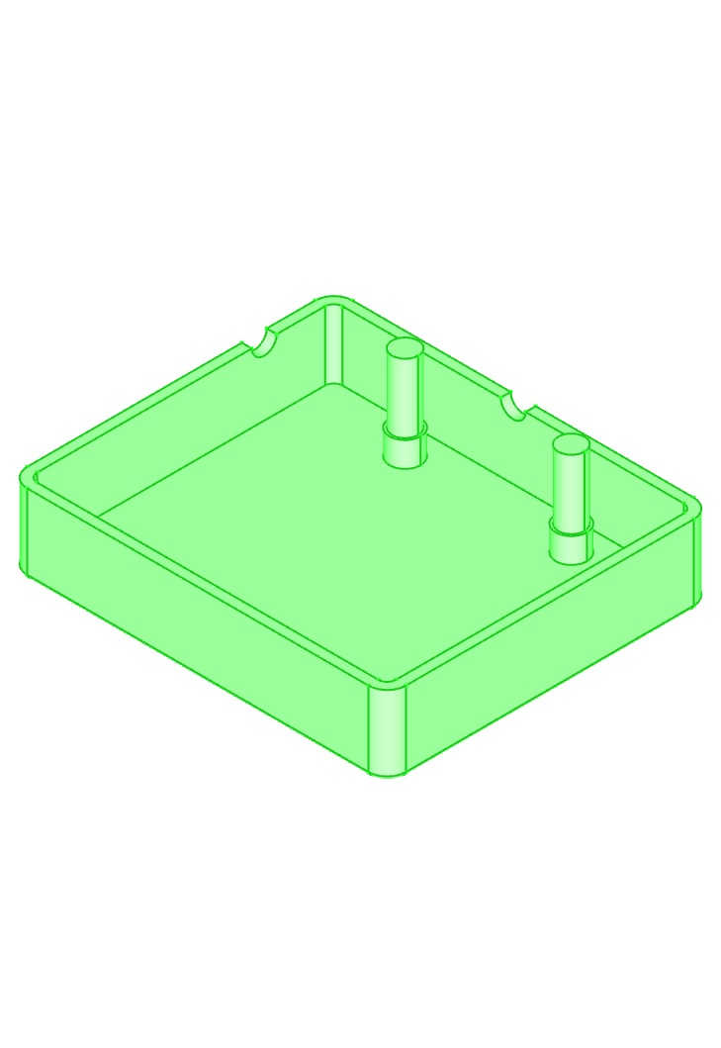
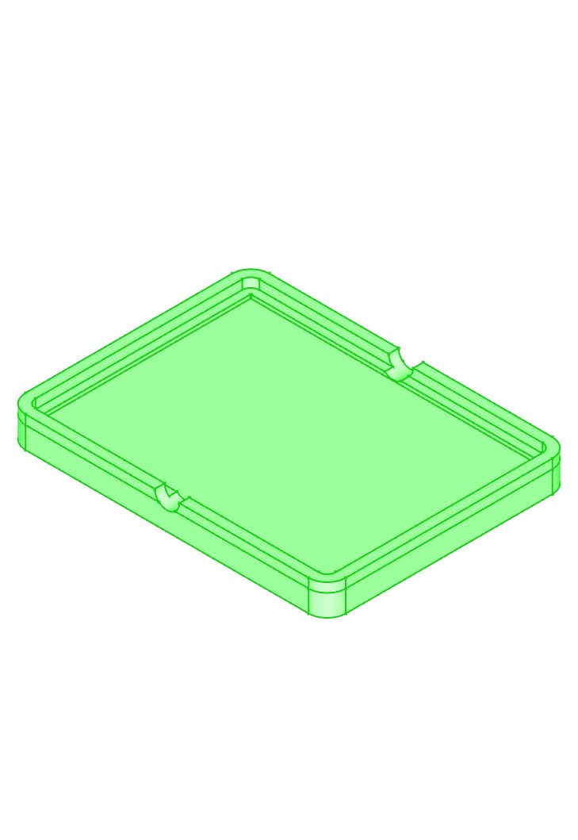
3D Printed Units
Custom LED & Button Casing
Custom Main Glove Casing
Notes:
Mat

Slide 8
Functional Tests: Glove Unit
Consistent voltage regulator output
MPU programmability
Bluetooth and Gyro Modules
Flex sensor characterization
Component current draw
Component integration
Notes:
Deb

Slide 9
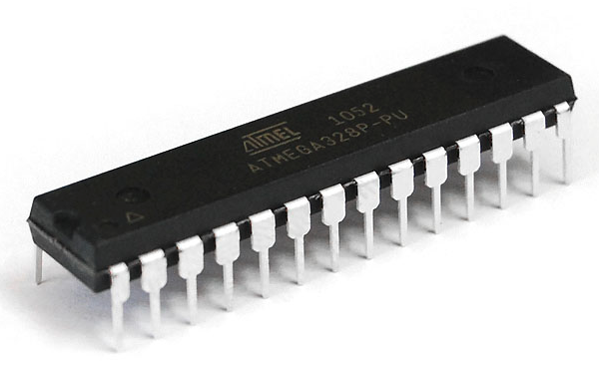
Microprocessor (ATmega328P)
High performance
Low power
Vast community support
Just enough analog and digital inputs
Source: KTechnics

Slide 10
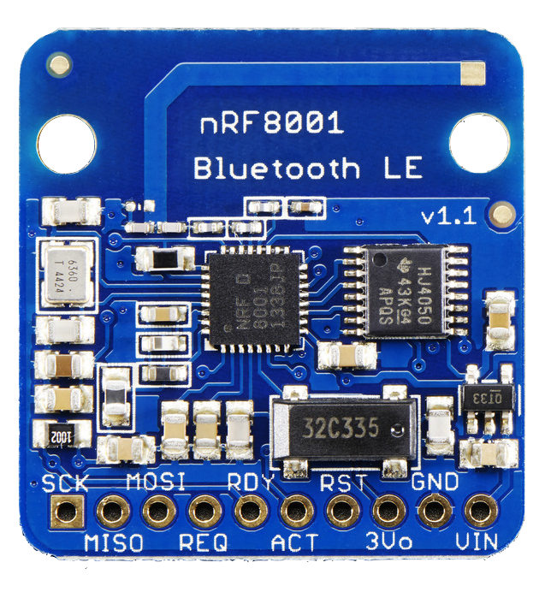
Bluetooth (nRF8001)
Low energy
Supports baud rates up to 19200
TXD/RXD UART Interface
Source: Adafruit Industries
Notes:
Ian

Slide 11
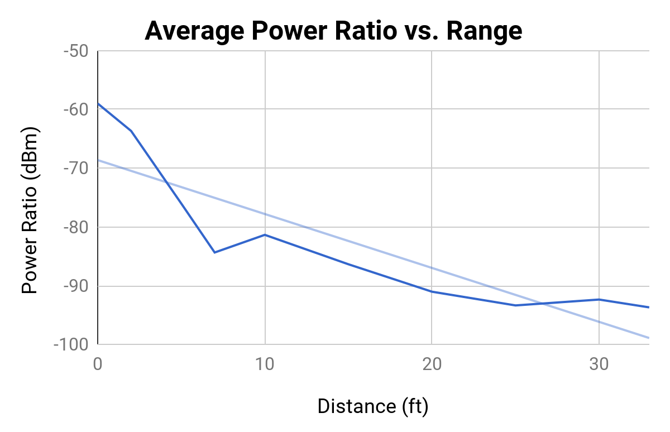
Bluetooth (nRF8001)
Point of unreliable data
Legend:
Data
Trendline

Slide 12
Factors Influencing Bluetooth Range
Antenna orientation
Environment
Interference from noise
Notes:
Ian

Slide 13
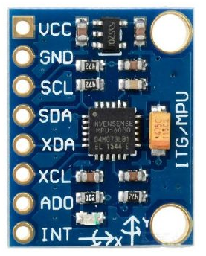
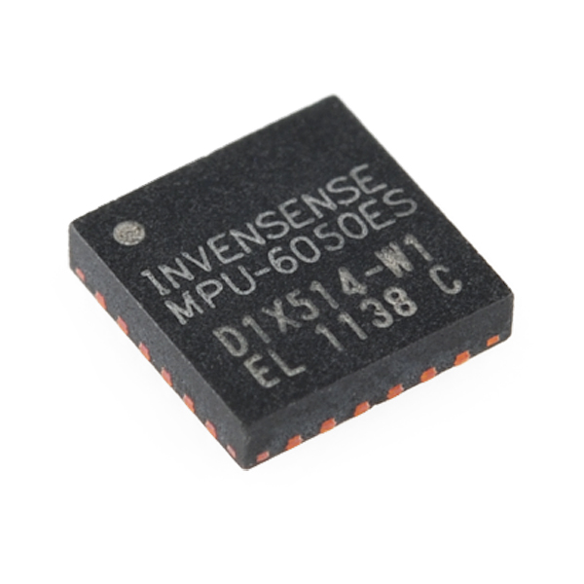
Gyroscope & Accelerometer (MPU-6050)
Drift handled by calibration
Chose to use Gyro values for simplicity
Additional gestures via gyro/accelerometer and buttons
Source: Makerlab Electronics
Source: InvenSense, Inc.
Notes:
Deb

Slide 14
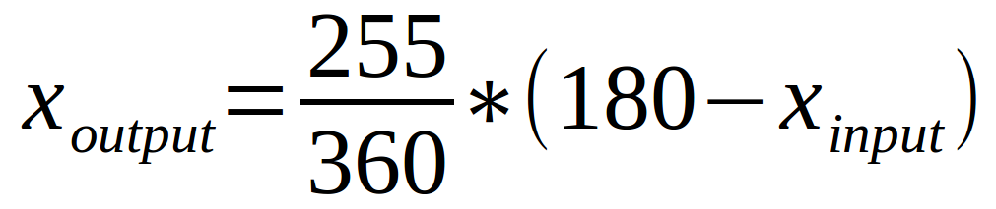
Calibration and Remap Calculation
Remaps raw gyroscope values to DMX512 values
Gyroscope range: -180 to 180
DMX512 range: 0 to 255

Slide 15
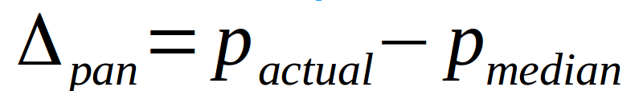
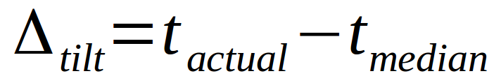
Calibration and Remap Calculation
Median pan value = 130
Median tilt value = 36
Final pan & tilt calculated using deltas

Slide 16
Battery (9V)
Glove Unit draws 31mA
Standard 9V alkaline battery capacity is 565mAh
Expected life of battery is 15.49 hours
Notes:
Ian

Slide 17
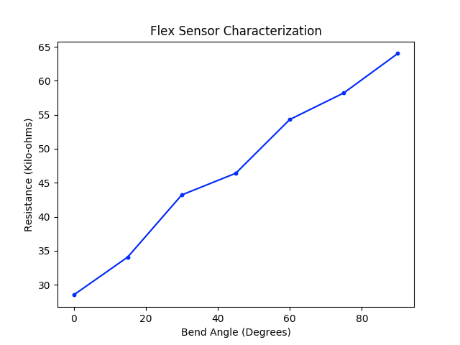
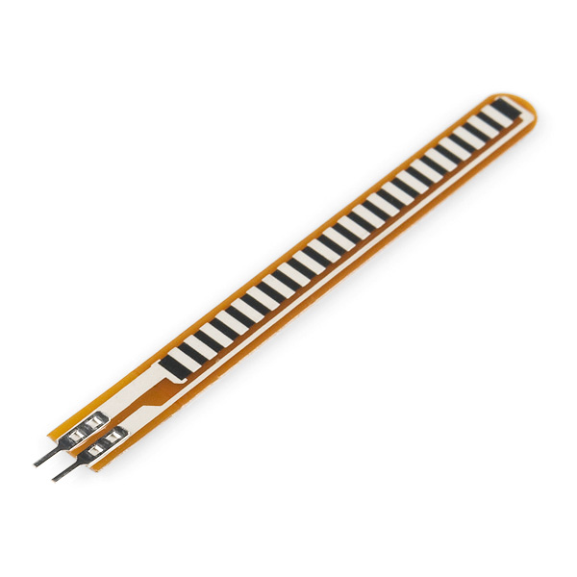
Flex Sensor
Cut-off
Source: Sparkfun
Notes:
Deb

Slide 18
Functional Tests: Main Control Unit
Runs ARMv7 Raspbian (based on Debian GNU/Linux)
Processing power is >= 900mHZ
Component integration
Pluggable Bluetooth
DMX USB Adapter

Slide 19
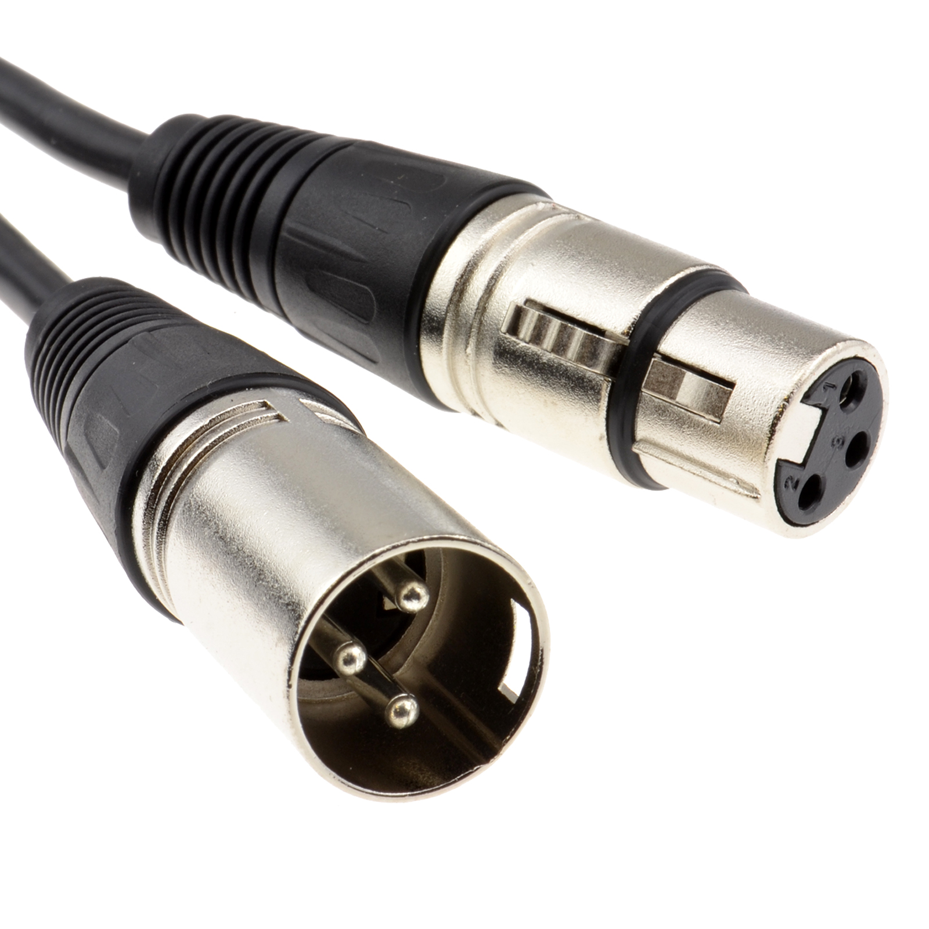
DMX512 Adapter and Lights
DMX512 protocol
Industry standard
Control infinite amount of universes
512 channels holding a value between 0 and 255
Source: B&H Photo

Slide 20
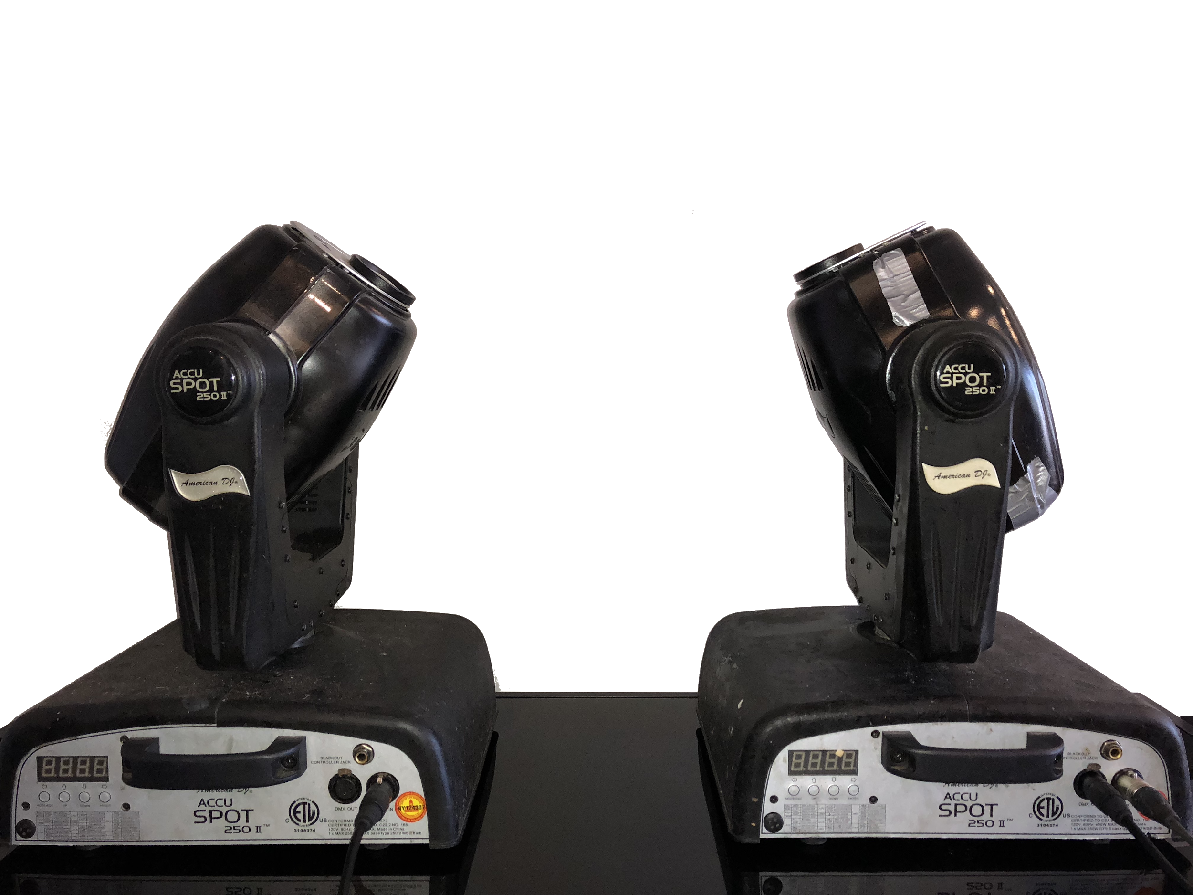
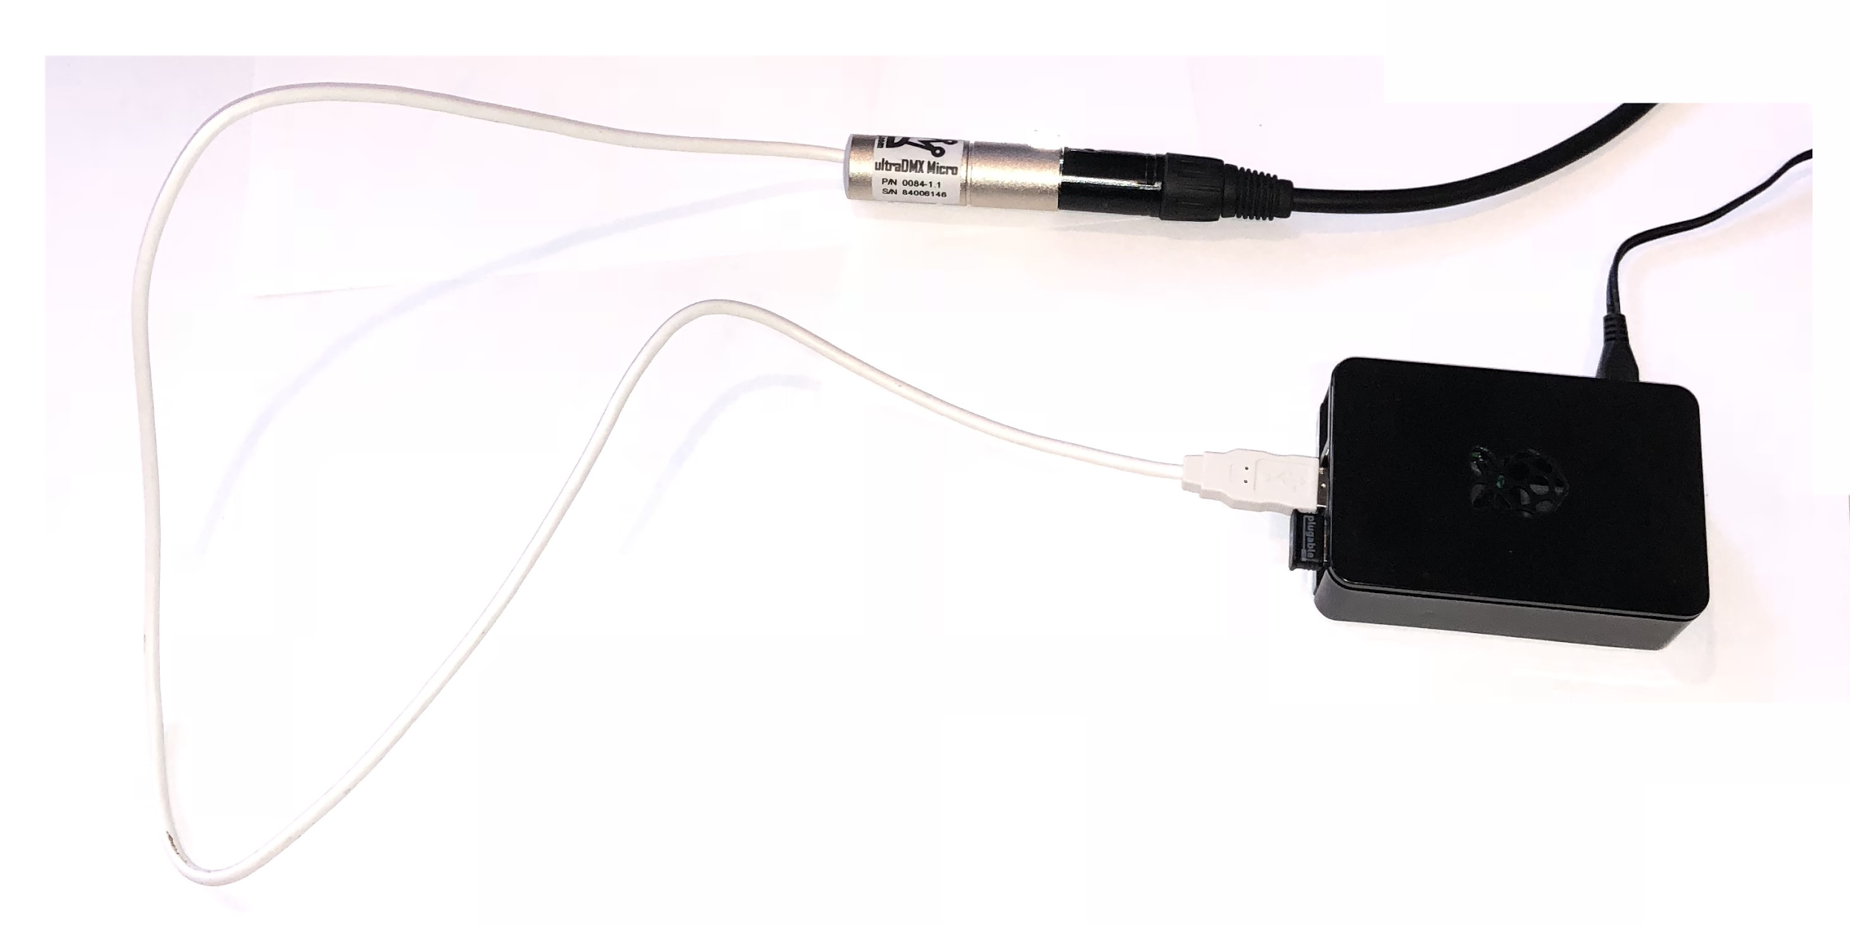

Slide 21
Four Main Challenges
Notes:
Ian

Slide 22
Four Main Challenges
Bluetooth Chip Selection
Notes:
Ian

Slide 23
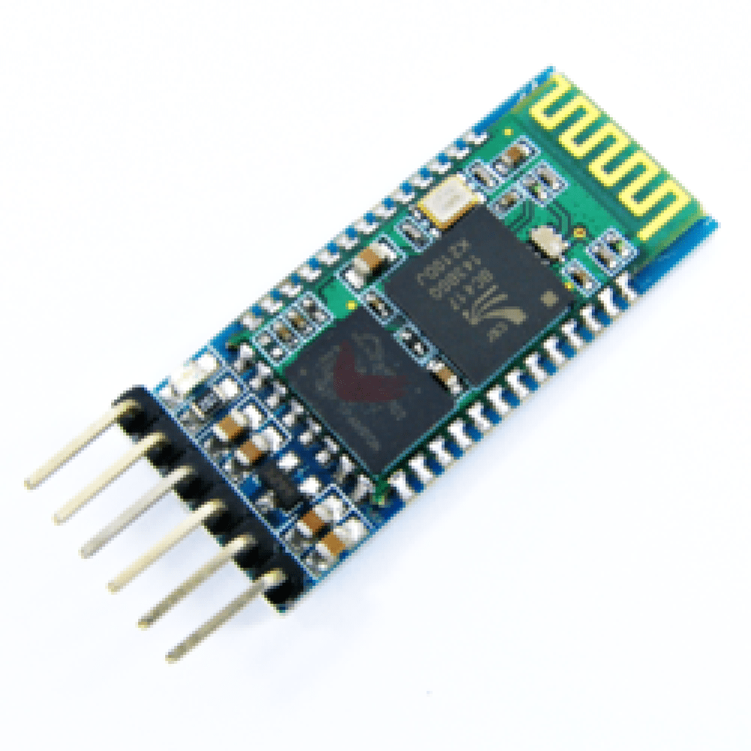
Bluetooth 2.0 vs Bluetooth 4.0
Bluetooth 2.0 (Classic) [HC-05]
Easier to program for both Glove & Main Control Unit
Power hungry
Source: Rosetta Electronics
Bluetooth 4.0 (Low Energy) [nRF80001]
Generic Attribute Profile (GATT) is more difficult to code
Reduced power consumption
Similar or equal range to Classic
AES Encryption
Source: Adafruit Industries
Notes:
Ian

Slide 24
Four Main Challenges
Bluetooth Chip Selection
Lack of Libraries
Notes:
Debjit

Slide 25
Lack of Libraries
Very few DMX-512 USB Driver options
Even fewer APIs
Open Lighting Architecture (OLA) Python API
Little to no documentation
Open-source
Variety of Bluetooth libraries
Limited selection of BLE for Python
Notes:
Debjit

Slide 26
Four Main Challenges
Bluetooth Chip Selection
Lack of Libraries
DMX-512 USB Driver in Python
BTLE in Python
PCB Complications
Notes:
Mat

Slide 27
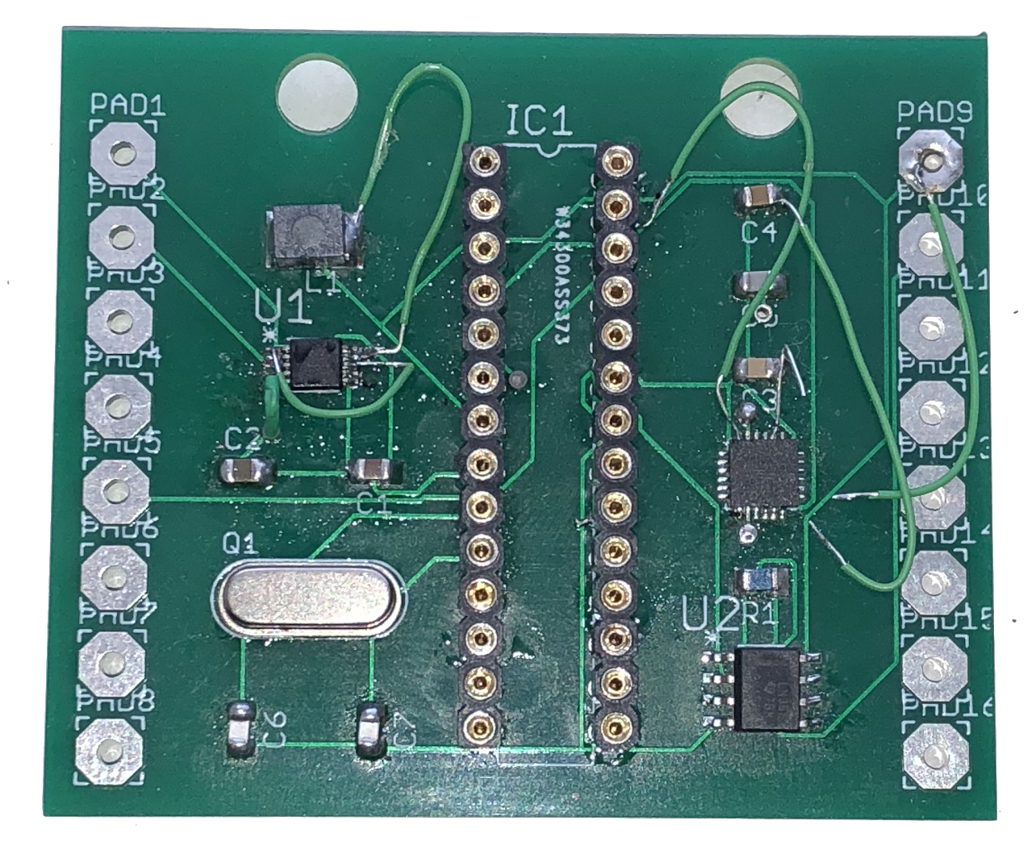
PCB Complications
Jumper wires to fix errors
Notes:
Mat

Slide 28
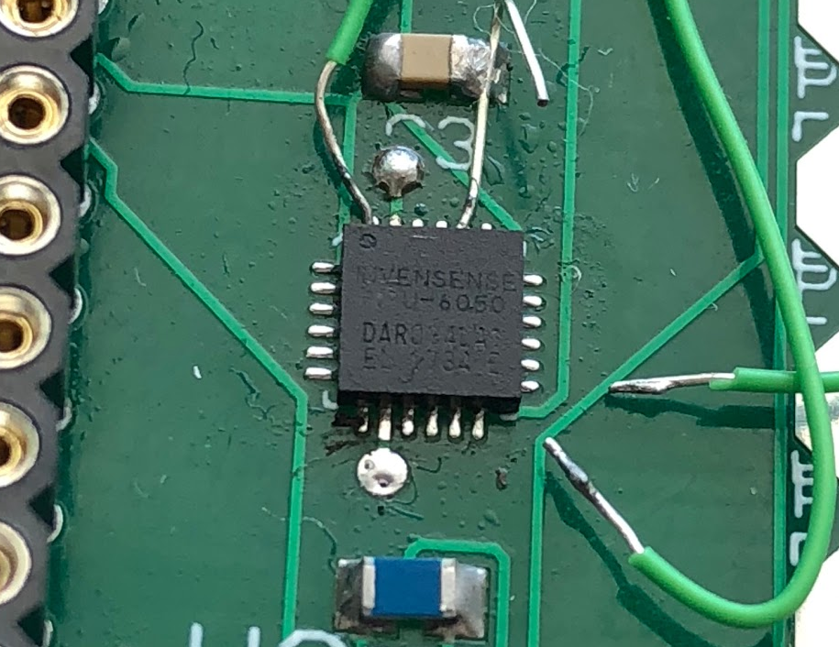
PCB Complications
Notes:
Mat

Slide 29
Four Main Challenges
Bluetooth Chip Selection
Lack of Libraries
DMX-512 USB Driver in Python
BTLE in Python
PCB Complications
SRAM Limitations
Notes:
Ian

Slide 30
SRAM Limitations
32KB of flash memory
Programs consumes 23KB (70%)
2KB of SRAM
Heap consumes 1.58KB
(76% of SRAM)
Stack overflow
Warning:
Low memory available, stability problems may occur.
Notes:
Ian

Slide 31
Going Forward
Shrink size of Glove Unit PCB
Reduce wires from Button Unit to Glove Unit
Use a more powerful Microcontroller
Add more lights and more features

Slide 32
Going Forward
Smart glasses unit
More responsive lights
Added gestures

Slide 33
Questions?

